Slide 1


Intro – Data Science
Shah Ayub Quadri
Ayub.quadri89@gmail.com

Slide 2
Intro & ML Algo
M1- Introduction to Data Science
Data Science & its roles
Types of Learning
Supervised, Unsupervised, Semi-Supervised & Reinforcement learning
Future of AI & Data Science
M2- Machine Learning Algorithms
Linear Regression
Multiple Regression
Logistic Regression
Time Series
Decision Trees
Clustering Techniques
SVM, PCA,
Neural Networks
Boosting Algorithms & Ensemble Techniques
Module M1 & M2 Exam

Slide 3
Story Telling & Visualization
M3- Visualizations & Story Telling
Art of story Telling
Analyzing & Visualization of Raw data
Insights of data
Graphs
Histogram
Pi-chart
Line & Bar Graphs
Box plot
Power of Colors & Shapes in Graphs
Visualization Tools
ggplot, ggplot2
Matplotlib
D3.js, Chart.js
Demo of MS-Power BI or Tableau
Module M3 Exam

Slide 4
Text Mining
M4- Text Mining
Search Engines
Language Modeling(Bi-gram, N-gram)
Query Retrieval system & Ranking
Relevance ranking (TF & TF-IDF Matrix)
Text Processing
Natural Language processing
Named Entity Recognition
Sentiment Analysis
Summarization
Module M4 Exam

Slide 5
Project submission & Viva
Self Learning
Doubt Clearance
Live Project

Slide 6
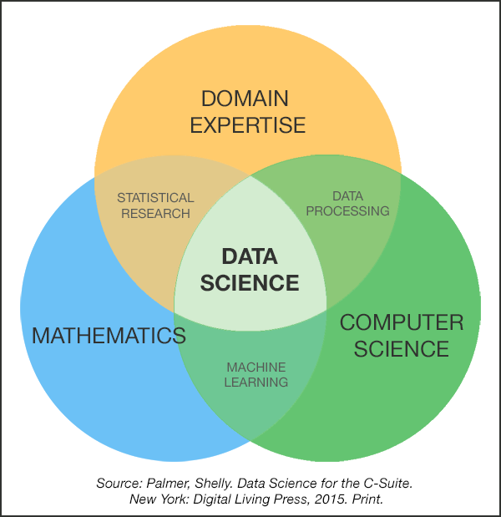
Data Science
Data science is the process of extracting meaning full insights from raw data which might be in structure or un-structured format.
What Data Science is not ?
No a piece of software – end to end App
Not about Visualization
Academic research – its more of providing business solution

Slide 7
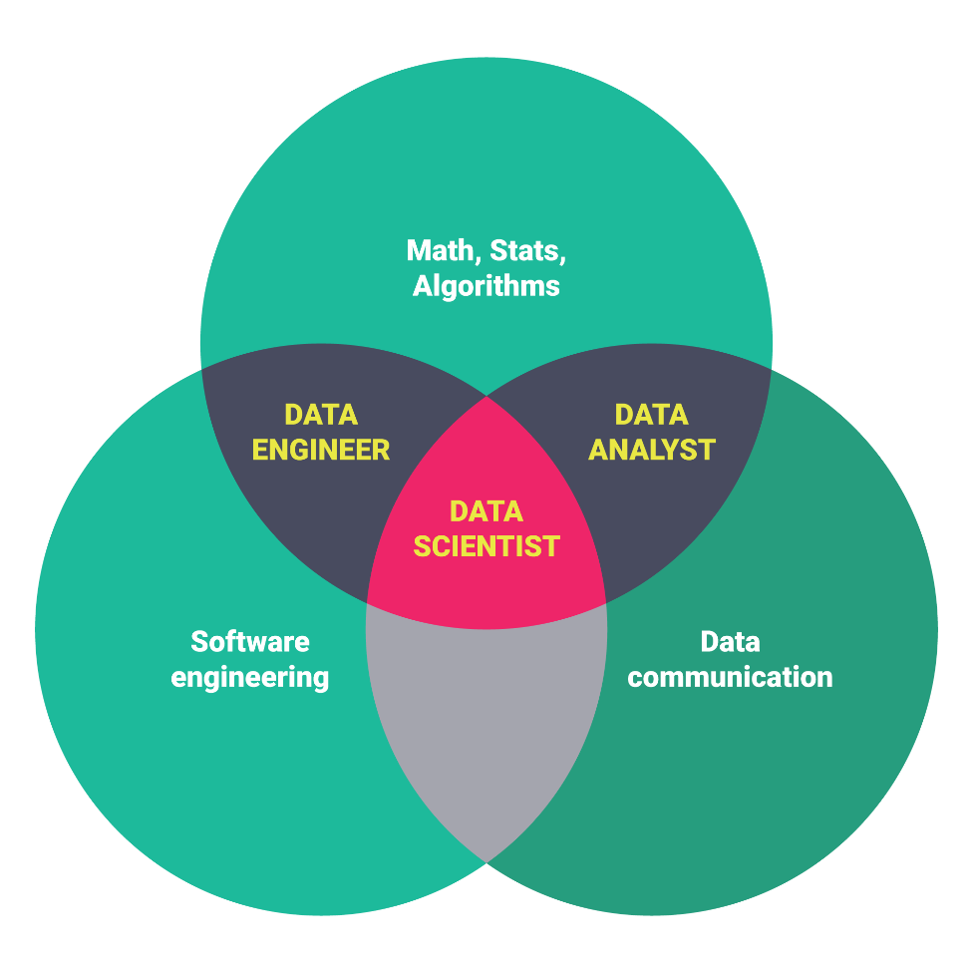
Roles in Data science
Data Scientist
Uses Various Algorithms to solve complex business problems
Data Engineer
Tries to handle huge data with proper constancy and availability
Data Analysts
Analysts draws the insights from raw data and understands/study the data by visualizing and grouping it
Different roles in DS: https://youtu.be/yR2wWQYiVKM

Slide 8

Machine Learning
Filed of study which gives computer the ability to learn on its own or without explicitly programmed.
~ Arthur Samuel(1959)
How to Teach Machines
Data
Machine learning Algorithms
Evaluate the model

Slide 9
Types of Learning
Supervised
Model is trained on labeled data or outcome is known
Unsupervised
Model learns it self with any labeled data or outcome
Semi-supervised
Model is trained on both labeled and un labeled data
Reinforcement Learning
Reinforcement learning is a self correcting way of learning, for every success its rewarded and for every failure it gets penalized.

Slide 10

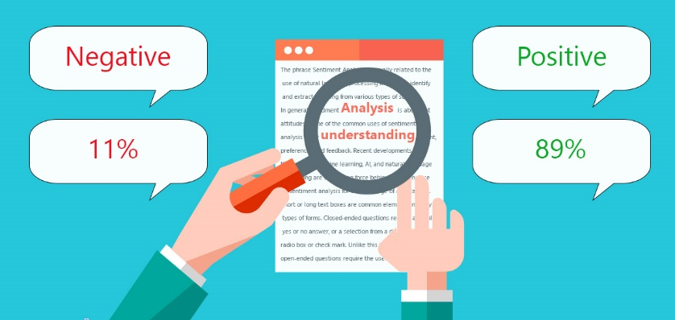

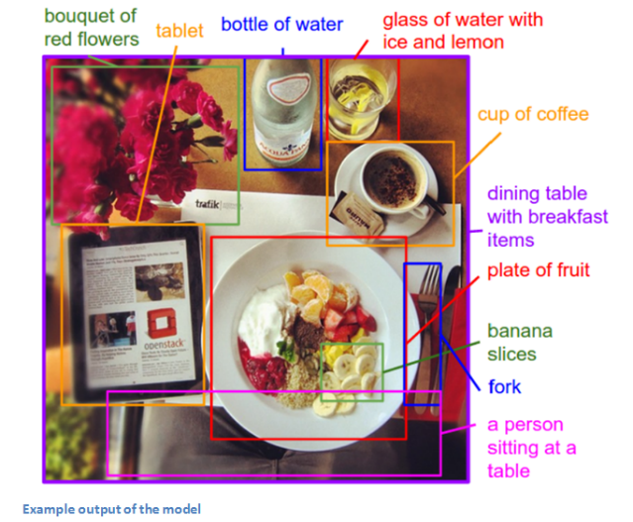

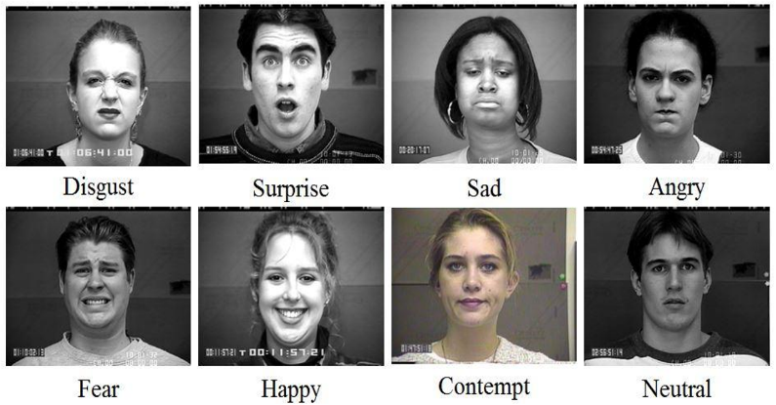
Future of AI & Machine Learning
Chat Bots
Sentiment analysis
Sales Predictions
Self Driven Cars
Facial Exp recognition
Image Tagging

Slide 11
Programming Languages
R Studio
Majorly used for statistical analysis (regression Time series)
Good Community support
ggplot, ggplot2 packages for visualization
Python
Majorly used for Text mining, sentiment analysis, neural nets, Deep Learning
Pretty good community with huge packages
Ntlk, TextBlob and other various packages for Text mining
Tensorflow and Keras for Deeplearning

Slide 12
Take away
Data Science?
Machine Learning?
Types of Learning?
Supervised
Unsupervised
Semi Supervised
Reinforcement learning
What is the future of AI & ML
Programming Languages
R
Python

